Slide 1
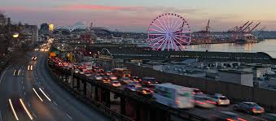
CAR ACCIDENT SEVERITY
IBM Specialization – Capstone Project

Slide 2
Introduction/Business Problem
The goal of this project is to predict the severity of a traffic accident. Car accidents are undesirable and dangerous for all traffic participants.
Information about road conditions and possibility of one getting into car accident and its intensity could be signal for changing a traffic route. This, along with driving safely at all time, could save many lives caused by traffic disasters.

Slide 3
Introduction/Business Problem
Prediction of traffic accident severity is one of the main things that improve traffic management process. Since car accidents are unexpected, recognition of most important influences might be a substantial key for improving traffic safety.
WHS consultant, facilitators, traffic consultants, safety officers and other people involved in traffic management process might find this kind of project quite useful.

Slide 4
Data
Data used in this project are data about traffic collisions recorded in Seattle area. All data are provided by Seattle Police Department and recorded by SDOT Traffic Management Division, Traffic Records Group since 2004. ​

Slide 5
Data
​
In total, there are 37 attributes. Target of the data is severity which describes the fatality of an accident and has two outputs: 1 - prop damage and 2 – injury.
Variable about date and time of recorded collision was transformed into another variable representing the level of risk based on time of the day.
After detailed examination, transforming and cleaning, features set was created.
​

Slide 6
Features Set
FEATURE | VALUE | DESCRIPTION | FEATURE | VALUE | DESCRIPTION
hour | 1 | Time/Hour of Low Risk of Collision |  | 7 | Blowing Sand/Dirt
 | 2 | Time/Hour of Moderate Risk of Collision |  | 8 | Fog/Smog/Smoke
 | 3 | Time/Hour of High Risk of Collision |  | 9 | Sleet/Hail/Freezing Rain
JUNCTIONTYPE | 1 | Ramp junction or unknown | ROADCOND | 0 | Dry
 | 2 | At Intersection (but not related to intersection) |  | 1 | Unknown or Other
 | 3 | Driveway Junction |  | 2 | Sand/Mud/Dirt
 | 4 | Mid-Block (but intersection related) |  | 3 | Standing Water
 | 5 | At Intersection (intersection related) |  | 4 | Snow/Slush
 | 6 | Mid-Block (not related to intersection) |  | 5 | Wet
UNDERINFL | 0 | Involved Driver Not Under Influence of Drugs or Alcohol. |  | 6 | Oil
 | 1 | Involved Driver Under Influence of Drugs or Alcohol. |  | 7 | Ice
WEATHER | 0 | Clear | LIGHTCOND | 0 | Daylight
 | 1 | Unknown or Other |  | 1 | Unknown or Other
 | 2 | Partly Cloudy |  | 2 | Dawn
 | 3 | Overcast |  | 3 | Dusk
 | 4 | Severe Crosswind |  | 4 | Dark - Street Lights On
 | 5 | Raining |  | 5 | Dark - Unknown Lighting
 | 6 | Snowing |  | 6 | Dark - Street Lights Off or No Street Lights

Slide 7
Methodology
​
Simple Logistic Regression
K-nearest Neighbours
Support Vector Machine
​

Slide 8
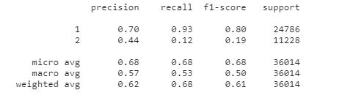
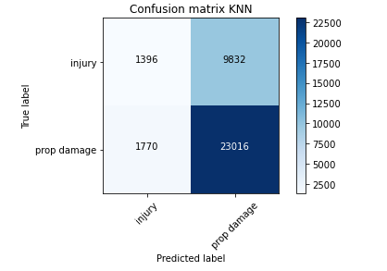
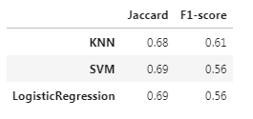
Results
​
KNN produced somewhat better results than the other two methods.
​

Slide 9
Discussion
​
Although it is reasonable to expect that accidents occur more often at some parts/hours of the day than the others, it is very noticeable that over 15% of accidents occur at 00-01 am. An hour earlier or later that percentage drops to 2%. Whether it was a coincidence or a mistake, it would be worth examining the reason. Contacting the provider and exploring ther explanation would result in some new findings. Those findings should be incuded in the model, possibly improving it.

Slide 10
Discussion
​
When an accident occurs, a police investigation includes assesment and recording of the speed of involved vehicles. Similar publicly available studies include a variable representing the speed above the allowed speed limit. I think that size should definitely be provided and the availability of such data would improve the model.

Slide 11
Conclusion
The main aim of this project was to apply several methods to classify the severity of an injury in car accidents in Seattle, WA area and compare which model makes the most accurate predictions about traffic injury severity.
Severity of an accident is labeled by two values. Since the binary output, a Simple Logistic Regression in this case was the most appropriate idea to start. Given the data structure, K-nearest Neighbours and Support Vector Machine algorithms were also taken into account. All models had some troubles classifying injury-class. KNN was somewhat more succesful than the other models.
The model has potential and I think it would give more concrete results and be more of a use if data and issues addressed in „Discussion“ part could be acquired and resolved.

